Slide 1

ML-Driven Bank Churn Prediction
This project aims to understand and predict customer churn in a banking context using machine learning. By analyzing customer behavior and demographics, the goal is to identify why customers leave and build a model to help the bank take proactive retention measures.

Slide 2


Data Overview
1
Dataset Size
10004 rows and 13 columns of Bank Churn data.
2
Key Features
Num Of Products, Has Credit Card, Age, Is Active Member, Geography – Germany and Balance & Balance To Salary Ratio
3
Target Variable
Customer Exited from Bank.

Slide 3
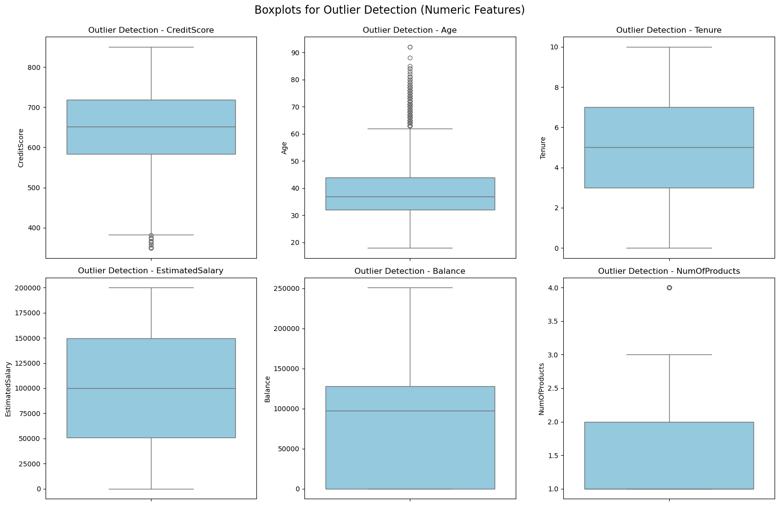
Data Preprocessing
1
Handling Missing Values
Dropped a small number of missing values to ensure data quality, as their proportion was negligible and had minimal impact on analysis.
2
Outlier Treatment
Outliers were retained as models like Random Forest and XGBoost are robust to them and unaffected in performance.
3
Feature Scaling
Feature scaling was applied to normalize the data and ensure uniformity across all features.

Slide 4
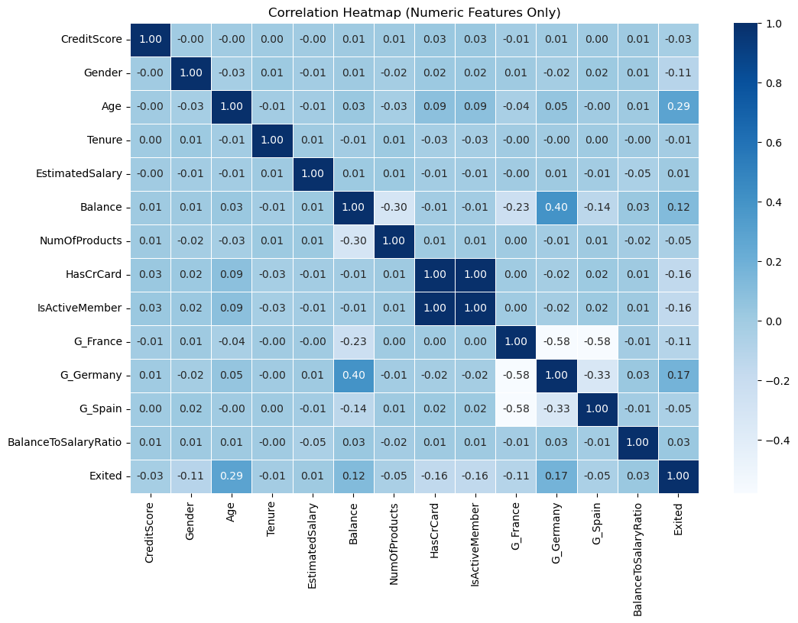
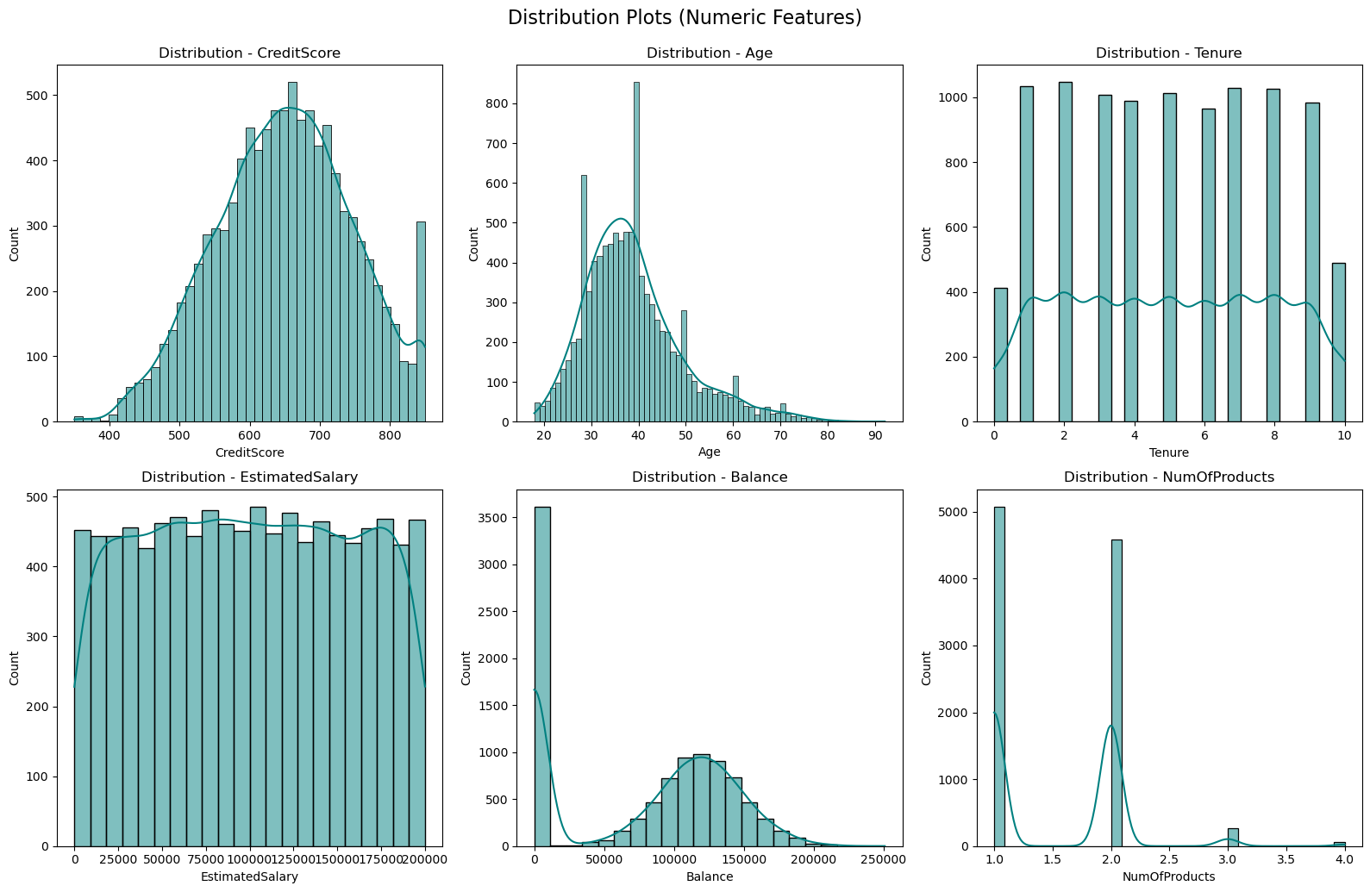
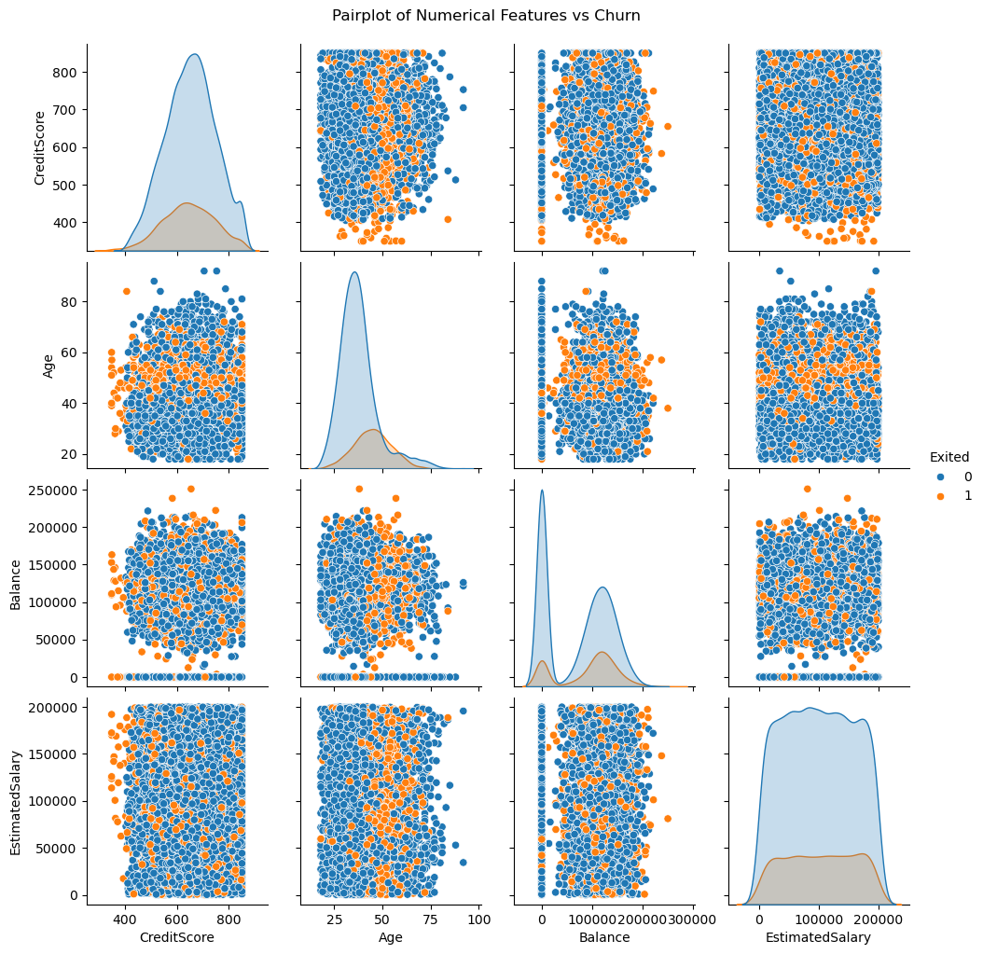
Exploratory Data Analysis
Correlation Analysis
Distribution Plots
Scatter Plots
Heatmap revealed relationships between variables, guiding feature selection.
Histograms showed data distributions, helping identify potential issues.
Pairwise scatter plots highlighted relationships between features and target variable.

Slide 5
Model Selection
Logistic Regression model
Random Forest Model
Advanced XGBoost Models
Used as a benchmark due to its simplicity and interpretability.
Chosen for its robustness to noise and outliers, and its ability to handle non-linear relationships and feature importance ranking.
Selected for its superior performance in structured/tabular data and its capability to handle class imbalance, regularization, and overfitting.
Models were compared using cross-validation and
performance metrics such as Accuracy, Precision, Recall, F1-score, and ROC-AUC.

Slide 6
Model Training and Evaluation
Data Splitting
Performance Metrics
80% training, 20% testing split for model evaluation.
Evaluated models using Accuracy score, Precision Score, Recall Score, F1-Score and ROC-AUC score.
1
2
3
Hyperparameter Tuning
optimize model parameters and enhance model performance.

Slide 7
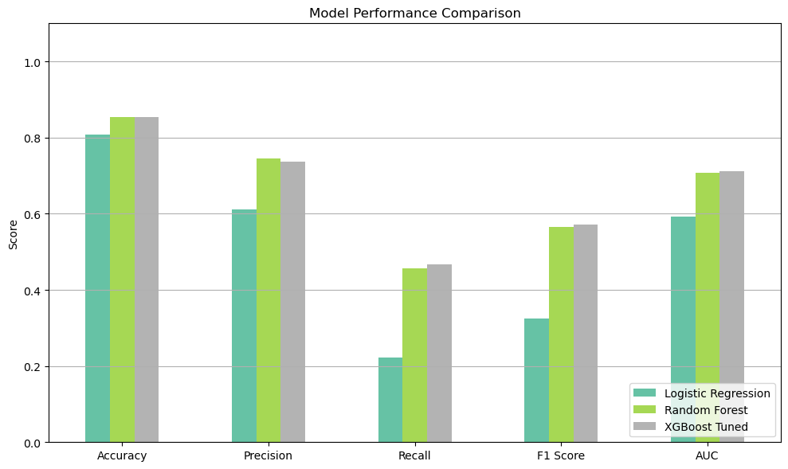
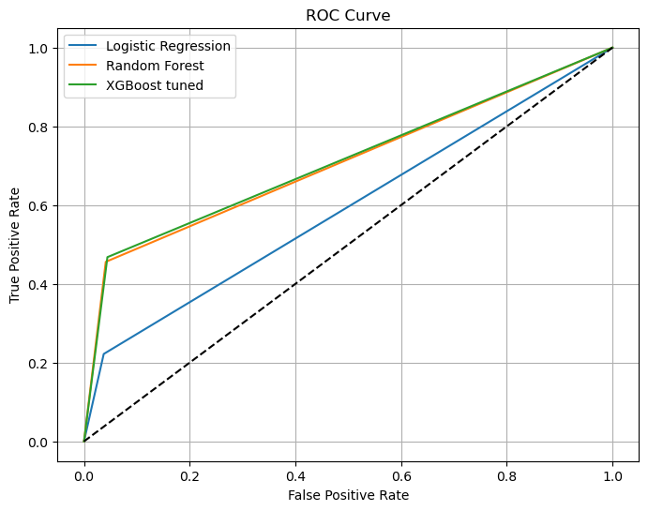
Model Performance Comparison
Best Performer
Runner-up
Baseline
XGBoost delivered the highest accuracy (85.35) and ROC-AUC(71.17)
Random Forest with accuracy (85.35) and ROC-AUC(70.7).
Logistic Regression with accuracy (80.75) and ROC-AUR (59.23)

Slide 8
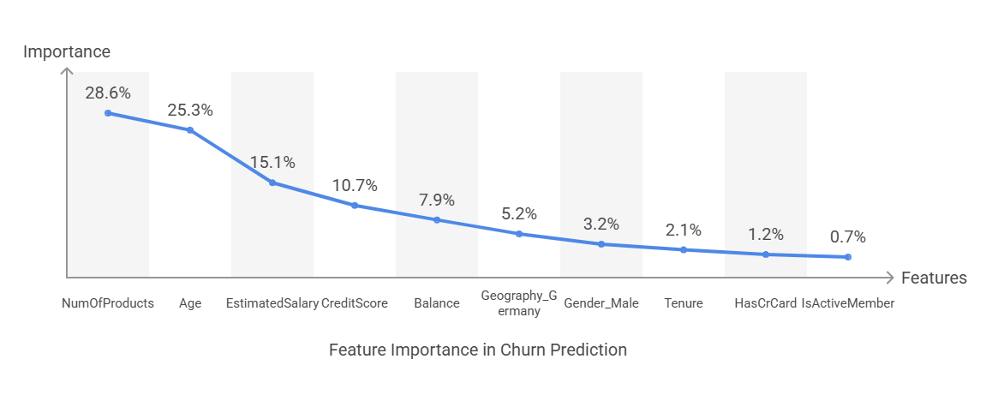
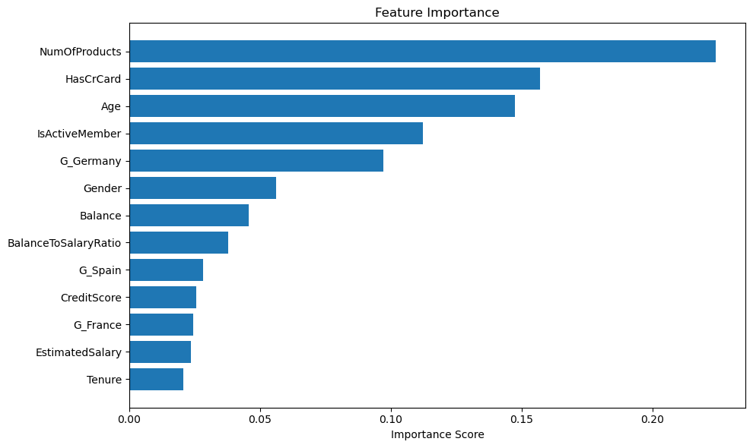
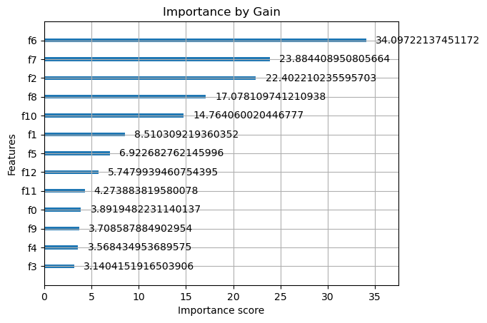
Feature Importance by XGBoost Gain

Slide 9

Key Findings
1
Best Model
XGBoost outperformed other models in predicting Customer Churn.
2
Important Factors
Num of Products, Age, Estimated Salary, Credit Score and Balance significantly influence Customer Churn Rate.
3
Model Accuracy
Achieved 85.35 % accuracy in predicting Customer Churn .

Slide 10
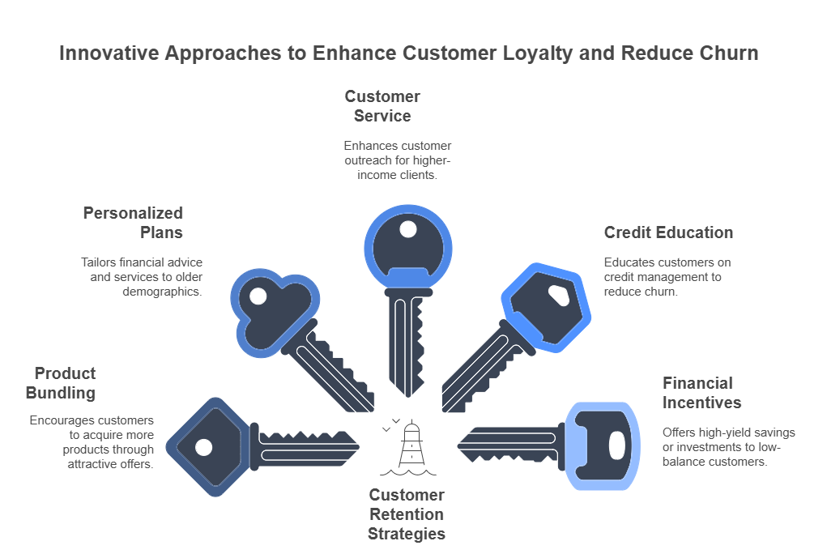
Key to reduce customer churn
For Top 5 Features

Slide 11
THANK YOU

